Slide 1
CHAPTER 4 – MEMORY AND FORGETTING
Learning Outcomes
At the end of this unit, students will be able to:
Define memory and forgetting.
Describe the stages and memory structures proposed by theory of memory.
Explain the processes that are at work in memory functions.
Identify how learned materials are organized in the long term memory.
State the factors underlying on the persistence, and loss of memory.
Explain different theories of forgetting

Slide 2
4.1. Memory
4.1.1. Meaning and Processes of Memory
  Memory is the retention of information/what is learned earlier over time.
Memory is the process by which information is encoded (phase1), stored (phase 2) and later retrieved (phase 3).
  It is the way in which we record the past for later use in the present.
  Memory is a blanket label for a large number of processes that form the bridges between our past and our present.
  To learn about the nature of memory, it is useful to separate the process from the structure.

Slide 3
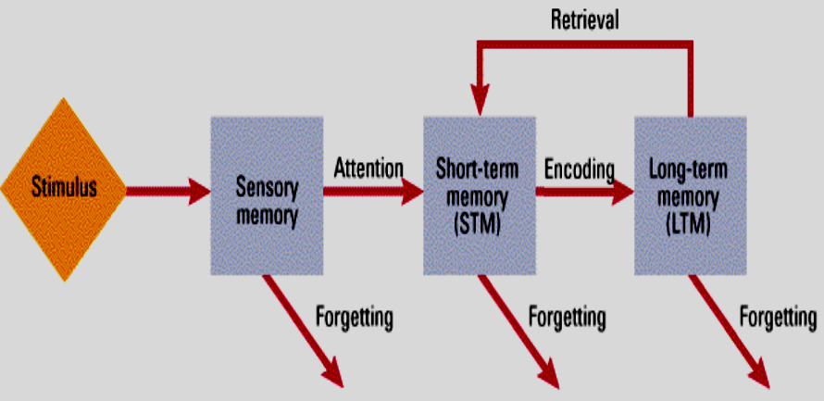
Processes of Memory
Memory processes are the mental activities we perform to put information into memory, to keep it there, and to make use of it later. This involves three basic steps: Encoding, Storing and Retrieval

Slide 4
Processes of Memory…
a) Encoding: It is the process by which information is initially recorded in a form usable to memory.
b) Storage: The process of maintaining information in a particular stage. Storage is the persistence of information in memory.
c) Retrieval: The process of bringing stored information from memory storage. In retrieval, material in memory storage is located, brought into awareness and used.

Slide 5
4.1.2. Stages/Structure of Memory
According to Atkinson and Shiffrin, memory has three structures:
1) Sensory Memory/Sensory Register: It is the entry way to memory.
  It can hold virtually all the information reaching our senses for a brief time.
  The information stored in sensory memory is a fairly accurate representation/replica of the environmental information but unprocessed.
  Most information briefly held in the sensory memory simply decays from the register. However, some of the information that has got attention and recognition pass on short-term memory for further processing.

Slide 6
4.1.2. Stages/Structure of Memory….contd
2) Short-term Memory: is part of our memory that holds the contents of our attention.
  Unlike SM, STMs are not brief replicas of the environmental message.
  STM is important in a variety of tasks such as thinking, reading, speaking, & problem solving
  STM is also referred as - working memory, immediate memory, active memory, and primary memory
contains input from two sources:
contents of sensory memory that we are paying attention
information recalled from LTM for retrieval

Slide 7
4.1.2. Stages/Structure of Memory….contd
Short term memory is distinguished by four characteristics:
It is active- information remains in STM only so long as the person is consciously processing
Rapid accessibility - Information in STM is readily available for use.
Preserves the temporal sequence of information- STM usually helps us to maintain the information in sequential manner for a temporary period of time.
Limited capacity- George Miller (1956) estimated the capacity of STM to be ―the magic number 7 plus or minus 2 (7±2 ).
  We could overcome this problem, by chunking
  STM memory holds information for up to about 30 seconds. It is possible to prolong STM indefinitely by rehearsal- the conscious repetition of information. (rehearsal)

Slide 8
4.1.2. Stages/Structure of Memory….contd
3. Long Term Memory: It is a memory system used for the relatively permanent storage of meaningful information
It holds information what we usually think
  The capacity of LTM seems to have no practical limits but limited by encoding & retrieval.
  LTM stores information for indefinite periods. It may last for days, months, years, or even a lifetime.

Slide 9
4.1.2. Stages/Structure of Memory….contd
The LTM is assumed to be composed of different sub systems/types:
Declarative/explicit memory- the conscious recollection of information such as specific facts or events that can be verbally communicated. It is further subdivided into semantic and episodic memories.
  Semantic memory- factual knowledge like the meaning of words, concepts and our ability to do math.
  Episodic memory- memories for events and situations from personal experience.
Non-declarative/ implicit memory- accessed without consciousness or implicitly through performance rather than recollection.
Also known as procedural memories b/c they tell as how to perform particular activities

Slide 10
Serial Position Effect
The three-box model of memory is often invoked to explain interesting phenomenon called the serial position effect….retention of any particular item will depend on its position in the list.
  That is, recall will be best for items at the beginning of the list (the primacy effect) and at the end of the list (the recency effect). When retention of all the items is plotted, the result will be a U-shaped curve.

Slide 11
Serial Position Effect…
According to the three-box model,
  The first few items on a list are remembered well because short-term memory was relatively ―empty when they entered, so these items did not have to compete with others to make it into long term memory. They were thoroughly processed, so they remain memorable.
  The last few items are remembered for a different reason: At the time of recall, they are still sitting in STM.
  The items in the middle of the list, however, are not so well retained because by the time they get into short-term memory, it is already crowded. As a result many of these items drop out of short-term memory before they can be stored in long-term memory.

Slide 12
III. Memory Retrieval
is the process whereby a stored memory is brought in to consciousness through recall
is the process of putting the contents of LTM in to working memory
some concepts used in retrieval
Tip-of-the-tongue (TOT):
Serial position effect:
Retrieval cues and retrieval tasks:
Emotional memories:
I. Flashbulb memories
II. Personal trauma
E. W/G
September, 2008

Slide 13
4.1.3. Factors Affecting Memory
Eleven Factors that Influence Memory Process in Humans are as follows:
  a. Ability to retain: This depends upon good memory traces left in the brain by past experiences.
  b. Good health: A person with good health can retain the learnt material better than a person with poor health.
  c. Age of the learner: Youngsters can remember better than the aged.
  d. Maturity: Very young children cannot retain and remember complex material.
  e. Will to remember: Willingness to remember helps for better retention.

Slide 14
Factors Affecting Memory (Contd.)
  f. Intelligence: More intelligent person will have better memory than a dull person,
  g. Interest: If a person has more interest, he will learn and retain better.
  h. Over learning: Experiments have proved that over learning will lead to better memory.
  i. Speed of learning: Quicker learning leads to better retention,
  j. Meaningfulness of the material: Meaningful materials remain in our memory for longer period than for nonsense material
  k. Sleep or rest: Sleep or rest immediately after learning strengthens connections in the brain and helps for clear memory.

Slide 15
4.2. Forgetting
4.2.1 Meaning and Concepts of Forgetting
Forgetting - the apparent loss of information already encoded and stored in the long-term memory.
it is the inability to retrieve and use information stored in memory system
The first attempts to study forgetting were made by German psychologist Hermann Ebbinghaus (1885/1913). Using himself as his only subject, he memorized lists of three letter non-sense syllables- meaningless sets of two consonants with a vowel in between, such as FIW and BOZ.
  He found that the most rapid forgetting occurs in the first nine hours of learning, and particularly in the first hour. After nine hours, the rate of forgetting slows and declines little, even after the passage of many days.
  There is almost always a strong initial decline in memory, followed by a more gradual drop over time.

Slide 16
4.2.2. Theories of Forgetting
4.2.2.1.The Decay Theory
  The decay theory holds that memory traces fade with time if they are not ―accessed now and then.
  Decay occurs in SM & STM, unless we rehearse the material. However, the mere passage of time does not account so well for forgetting in long-term memory.
  Although there is evidence that decay does occur, it does not seem to be the complete explanation for forgetting.

Slide 17
4.2.2. Theories of Forgetting…. contd
4.2.2.2. Interference
  Interference theory holds that forgetting occurs because similar items of information interfere
  with one another
  There are two kinds of interference that influence forgetting:
    Proactive Interference, information learned earlier interferes with recall of newer material.
    Retroactive Interference, new information interferes with the ability to remember old information

Slide 18
4.2.2. Theories of Forgetting…. contd
4.2.2.3. New Memory for Old/ Displacement Theory
This theory holds that new information entering memory can wipe out old information
  This theory is mostly associated with the STM, where the capacity for information is limited to seven plus or minus chunks.
  It cannot be associated with the LTM because of its virtually unlimited capacity.

Slide 19
4.2.2. Theories of Forgetting…. contd
4.2.2.4. Motivated Forgetting/Repression
  Freud- forgetting occurs because people block from consciousness those memories that are too threatening or painful to live with
4.2.2.5. Cue Dependent Forgetting
  Cues that were present during initial stage of learning, help us to recall the content of the specific learning materials in an easy manner. And Lack of this retrieval cues could result in forgetting.
  In long-term memory, this type of memory failure may be the most common type of all.
    Remembering is often easier when you are in the same physical environment/ mental state as you were when an event occurred

Slide 20
4.3. Improving Memory
Pay Attention
Encode information in more than one way: The more elaborate the encoding of information, the more memorable it will be
Add meaning: The more meaningful the material, the more likely it is to link up with information already in long-term memory.
Take your time: If possible, minimize interference by using study breaks for rest or recreation. Sleep is the ultimate way to reduce interference.
Over learn: Studying information even after you think you already know it- is one of the best ways to ensure that you‘ll remember it.
Monitor your learning: By testing yourself frequently, rehearsing thoroughly, and reviewing periodically, you will have a better idea of how you are doing

Slide 21
THE END
THANK YOU VERY MUCH
E. W/G
September, 2008

